Slide 1
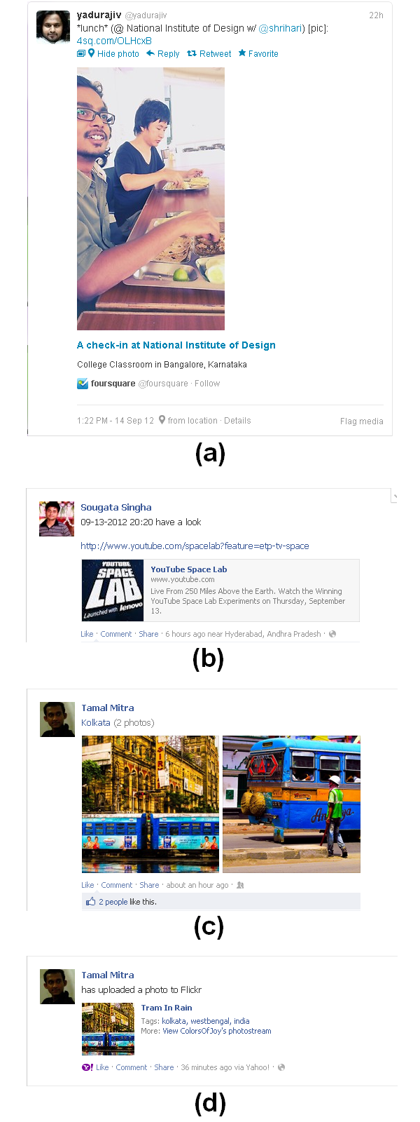
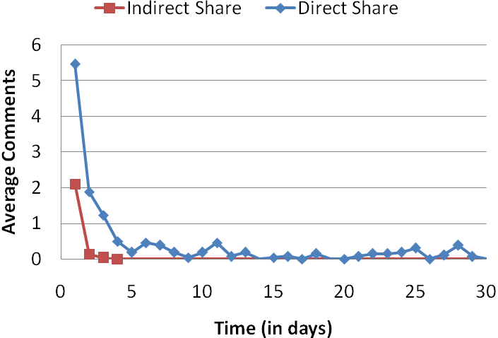
Result and Analysis
 | Direct Share (average per post) | Indirect Share (average per post)
comments | 13.00 | 2.28
likes | 34.92 | 5.48
total | 47.92 | 7.76
Background
Sharing of content is an important part of growing social networking culture.
UGC is defined as “the work that is published in some context, be it on a publicly accessible website or on a page on a social networking site only accessible to a select group of people”.
The presentation of the post on SNS sometimes differs when the UGC is created on it and when created on other media-sharing sites.
We divide the shared content into two categories: direct share, where the content is created in SNS and indirect share, where the UGC is created in other websites/web-services.
Ineffective Sharing
Performance of one-sided two-sample equal variance T-tests at 5% significance level:
H1 Data Set: The first set contains 3 values for each of direct and indirect shares corresponding to average comments, average likes and average activities per post over a period of 30 days (see Table 1).
H1 is supported by a P-value of 0.0301.
H2 Data Set: The second set contains day-by-day records of average number of posts from day 1 to day 30 (see Figure 2)
H2 had a P-value of 0.0398.
H1. Indirect shared content is less popular than direct shared content.
The popularity of the content can be measured as an aggregation of (1) number of people shares/repost the article, (2) number of people likes it or mark it as favorite, and (3) number of comments.
H2. Indirect shared content is short lived as compared to direct shared contents in SNSs.
We propose that it is more likely that direct share will have a larger life cycle as compared to indirect share.
Notes:
On Effective Sharing of UGC [APCHI 2013]

